Slide 1


Introduction
Treasure Valley Groundwater Flow Model Training
Stephen Hundt,
March 14th, 2023

Slide 2
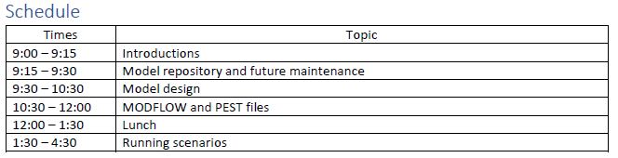
Basics and Logistics
Bathrooms: take hallways beyond front desk. Across from the stairs and elevator.
Emergency exits are through the doors you entered – go across to the tennis courts in case of evac
Snacks & coffee – help yourselves
Lunch – on your own; 1 ½ hours
Schedule:
With breaks as needed
Try to end early if we can
I’ve never talked for so long – I don’t know if I can…

Slide 3
Introductions
Name
Organization
Experience with MODFLOW
How might you use the Treasure Valley Groundwater Flow Model?

Slide 4
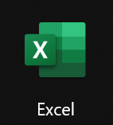
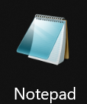
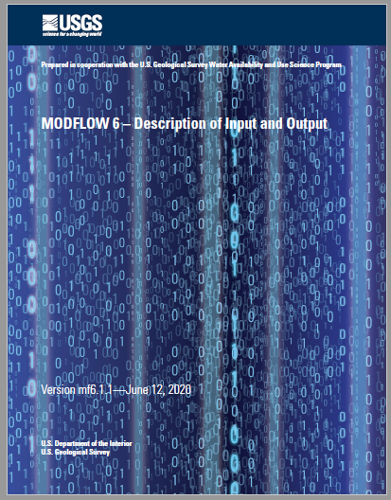
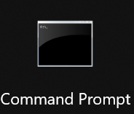
Scope and Caveats
Training was designed for groundwater modelers
Limited description of model design and MODFLOW file input and output structure
Focus on components of model contents of model files
We’re using basic tools
No GUI
No python / scripting
Text editors, command prompt, excel

